Slide 1

Chapter 10
Cultural Diversity
and Communication

Slide 2
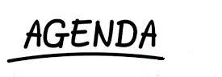
Cultural Anthropology
Approaches to Studying Culture
Cultural Intelligence Quotient (CQ)
Cultural Competence

Slide 3
Thinking Like an Anthropologist
Culture
Counter-culture
Sub-culture
Ethnic Group

Slide 4
Culture
Culture is the learned and shared understandings among a group of people about how to behave and what has meaning in our lives.
Subculture- a particular mix of shared understandings held by a group within a larger society.
Ethnic group – functions within society to maintain a subculture based on religion, language, common origin, or ancestral traditions.

Slide 5
Characteristics of a Culture
Integrated
Product of History
Changeable
Strengthened by Values
Influences Behaviour
Transmitted by Symbols
Complex and Variable

Slide 6

Nonverbal Communication Reflects and Expresses Cultural Values

Slide 7
Approaches to the Study of Culture
Aggregate Approach
Core cultural values and context
Individualistic Approach
Unique sense of self
Cultural Intelligence Quotient
Head, body, heart

Slide 8
Aggregate Approach
High Context
Low Context
Close Connection/ Long Time
Many Connections/ Short Time

Slide 9
Aggregate Approach
Individualism
Collectivism
Focus on the self
Focus on the collective

Slide 10
Aggregate Approach
Uncertainty Avoidance
Uncertainty Acceptance
Note tolerant of the unknown and ambiguity
Tolerant of difference opinions and lack of structure

Slide 11
Aggregate Approach
Masculinity
Femininity
Distinct social gender roles
Social gender roles overlap

Slide 12
Aggregate Approach
Short-term Orientation
Long-Term Orientation
Fulfilling social obligations, present-focus
Hamper institutional change, values future

Slide 13
Dimensions of Value Differences
Time
Monochronic
Polychronic
Context
Low
Power
Short-term
Orientation
Gender
Uncertainty
High
Rights
Low
High
Individual
Collective
Masculine
Feminine
Acceptant
Avoidant
Long-term

Slide 14
Guidelines for Improving Cultural Intelligence
Cultural Intelligence Profiles
Cultivating Your Cultural Intelligence
Cognitive CQ
Analogical and Inductive Reasoning
Motivational CQ
Physical CQ
Cultural Competence in Organizations
Cultural Competence in Health Care
Cultural Competence in Business
Putting Ethnocentricity into Perspective

Slide 15
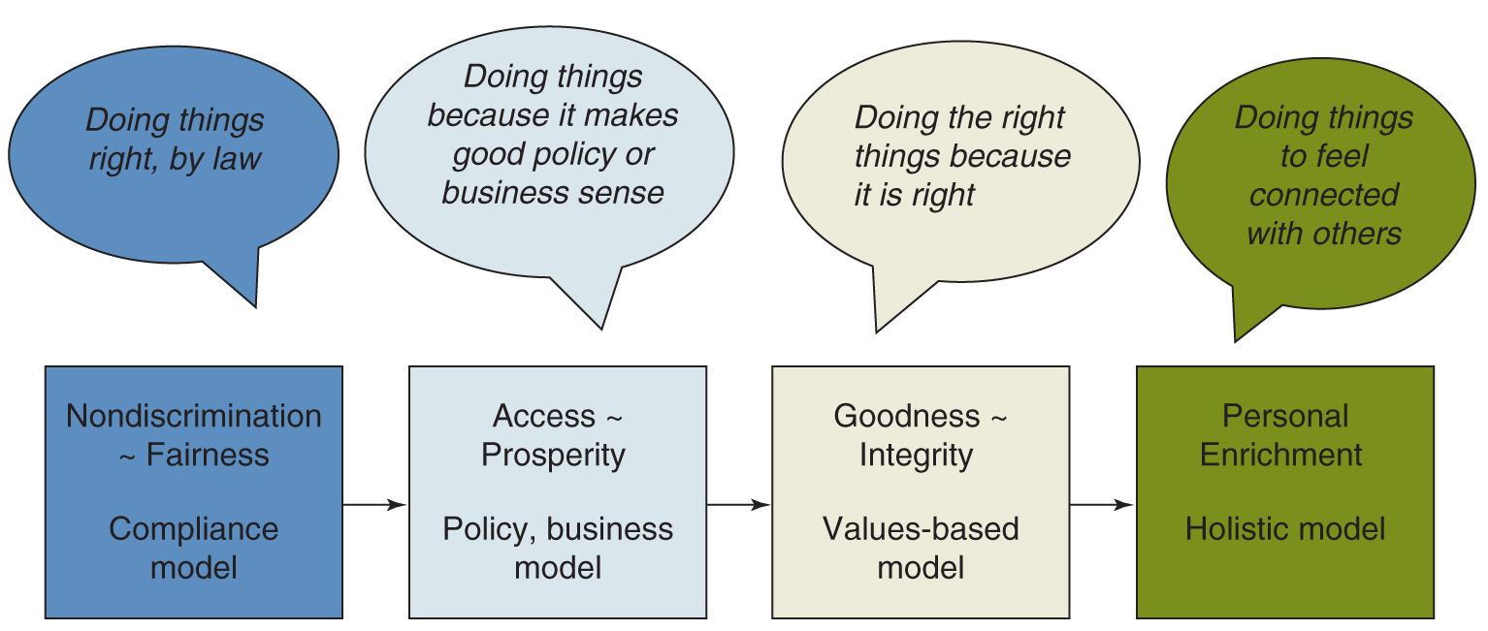
Cultural Intelligence Profiles

Slide 16
Cultivating Your Cultural Intelligence
Cognitive CQ
Analogical and Inductive Reasoning Exercises
Emotional/
Motivational CQ
Awareness Exercises
Physical CQ
Response Exercises

Slide 17
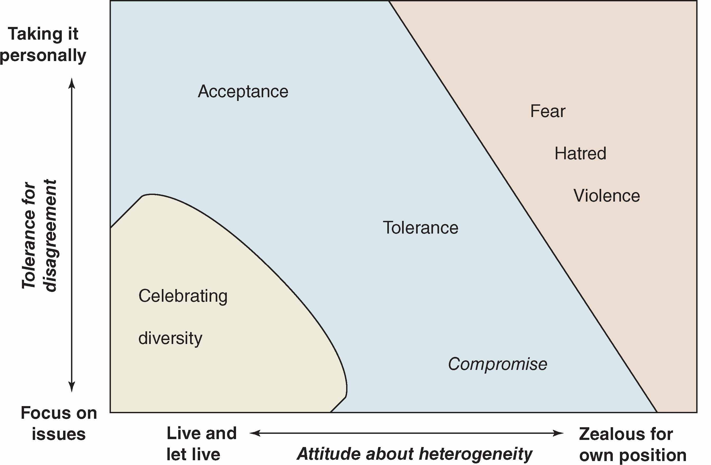
Putting Ethnocentrism into Perspective

Slide 18
Summary
Culture and Sub-culture
Cultural Competence
Characteristics
Chapter 10
CQ
Nonverbal Comm.
Individualistic Approach
Aggregate Approach

